Slide 1
Topic: Time EQ: How Do I Convert Between 12 and 24 Hour Time?
Year 11 Mathematics Essentials

Slide 2
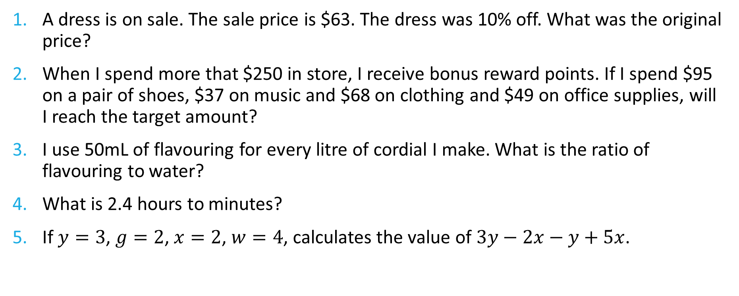
Five Questions
Topic: Time
Date: XX/XX/2021
EQ – How do I convert between 12 hour and 24 hour time?
A dress is on sale. The sale price is $63. The dress was 10% off. What was the original price?
When I spend more that $250 in store, I receive bonus reward points. If I spend $95 on a pair of shoes, $37 on music and $68 on clothing and $49 on office supplies, will I reach the target amount?
I use 50mL of flavouring for every litre of cordial I make. What is the ratio of flavouring to water?
What is 2.4 hours to minutes?
If $y=3$, $g=2$, $x=2$, $w=4$, calculates the value of $3y−2x−y+5x$.
Notes:
$70
No
50:950 = 1:9
144 minutes
22

Slide 3
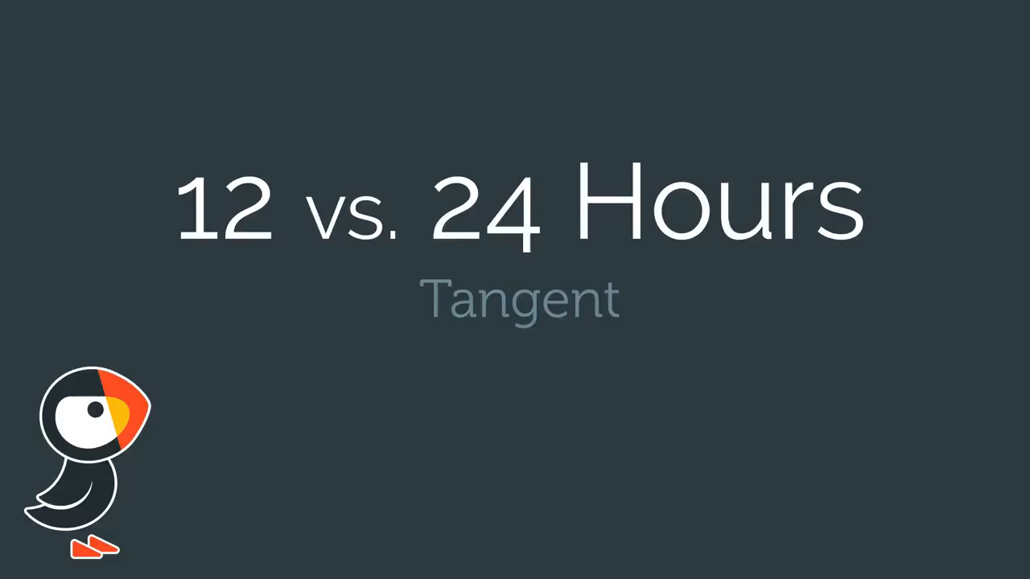
12 hour vs 24 hour time
https://www.youtube.com/watch?v=i7L71i9uv3o

Slide 4
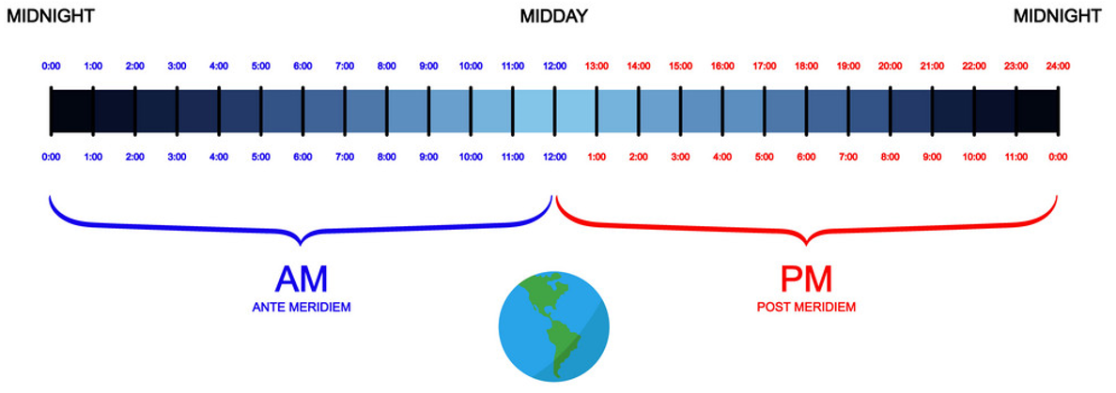

Slide 5
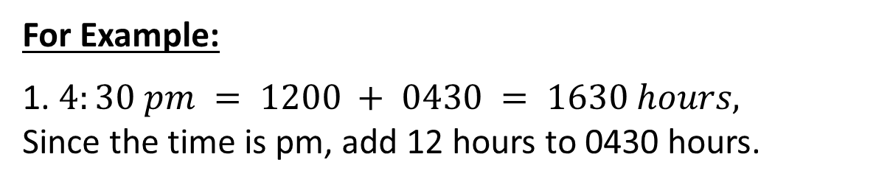
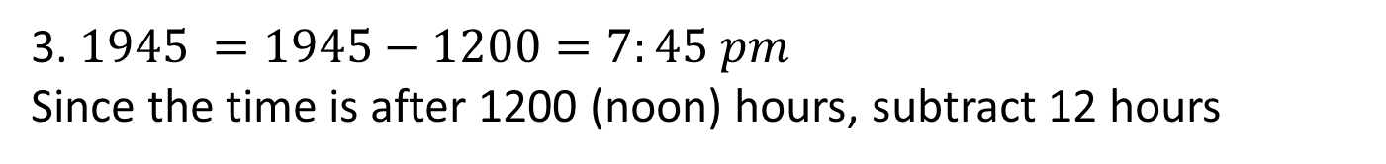
24
7
30
Date: XX/XX/2021
Topic: Time
EQ – How do I convert between 12 hour and 24 hour time?
Today we use
am – ante meridiem – Latin for (before noon) and
pm – post meridiem (after noon).
What is 12 hour time?
What is 24 hour time?
24 hour time shows the number of hours and minutes after midnight.
For Example:
1. $4:30 pm = 1200 + 0430 = 1630 hours,$
Since the time is pm, add 12 hours to 0430 hours.
2. $7:00 am =0700 hours$
3. $1945 =1945−1200=7:45 pm$
Since the time is after 1200 (noon) hours, subtract 12 hours
WICOR

Slide 6
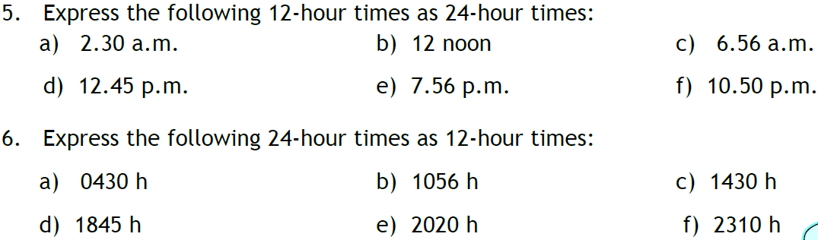
Task

Slide 7
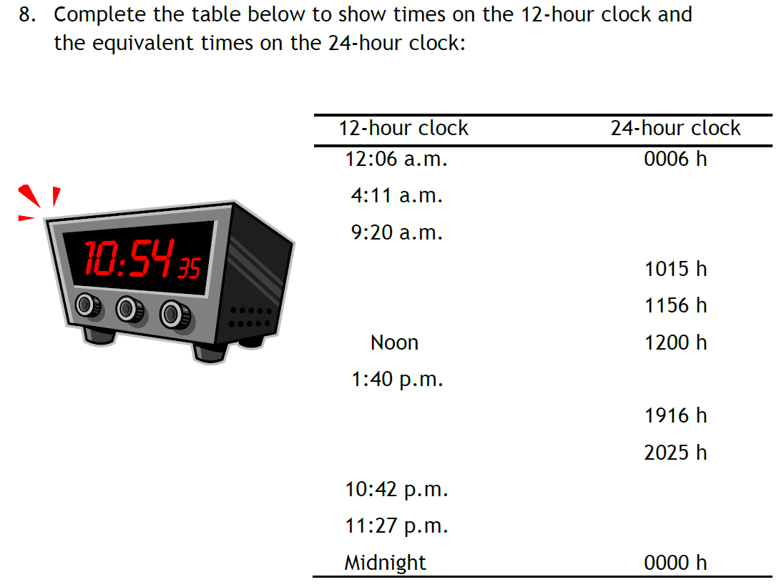
Task(LHS)

